Slide 1
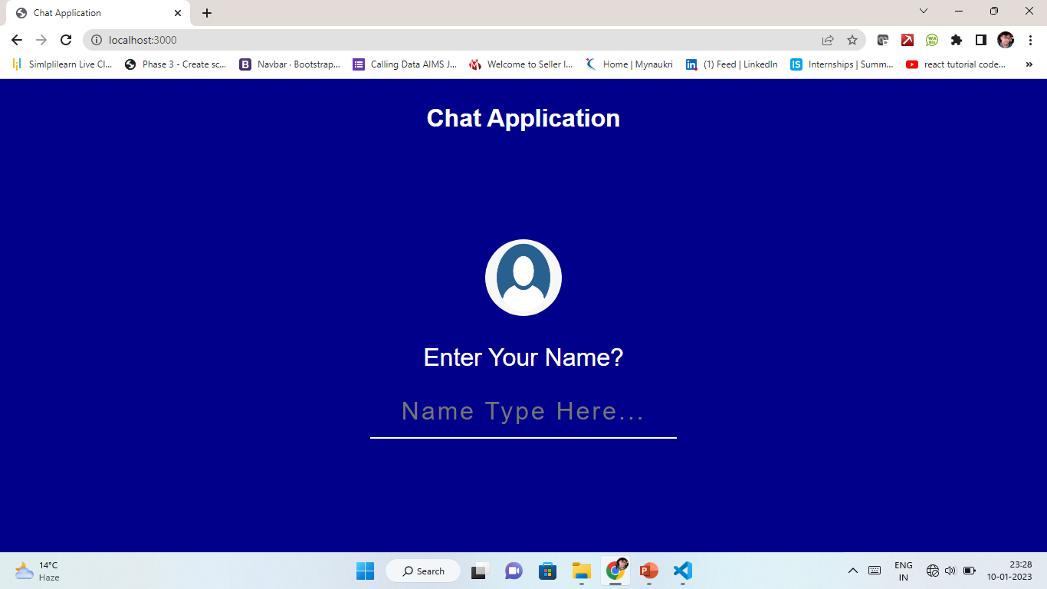
HOME Page

Slide 2
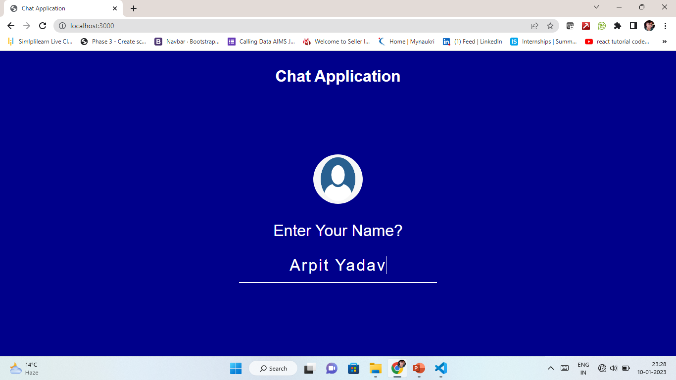
HOME Page

Slide 3
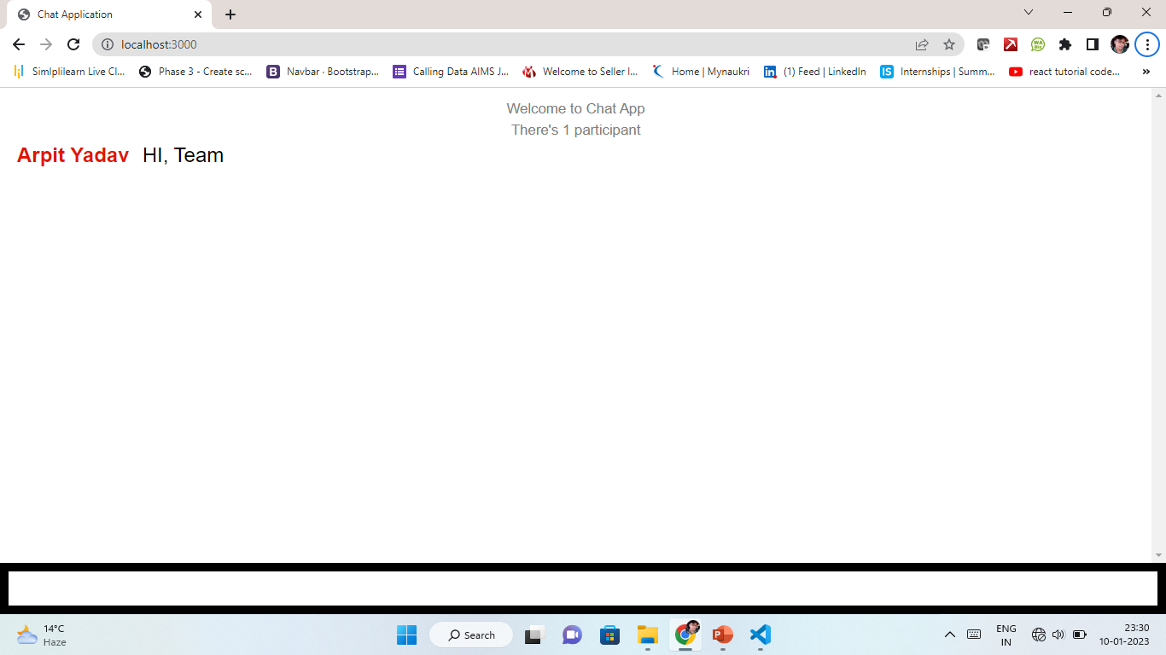
Typing A
Chat-1

Slide 4
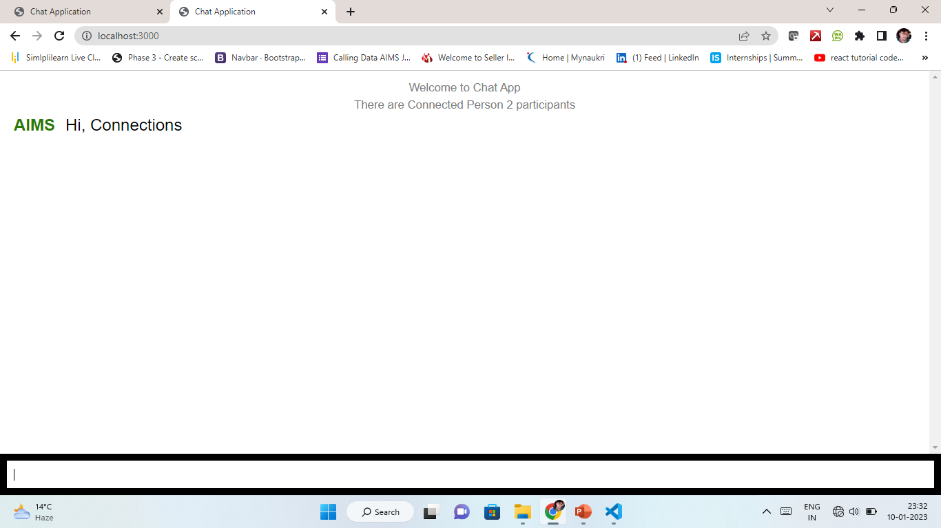
Typing A
Chat-2

Slide 5
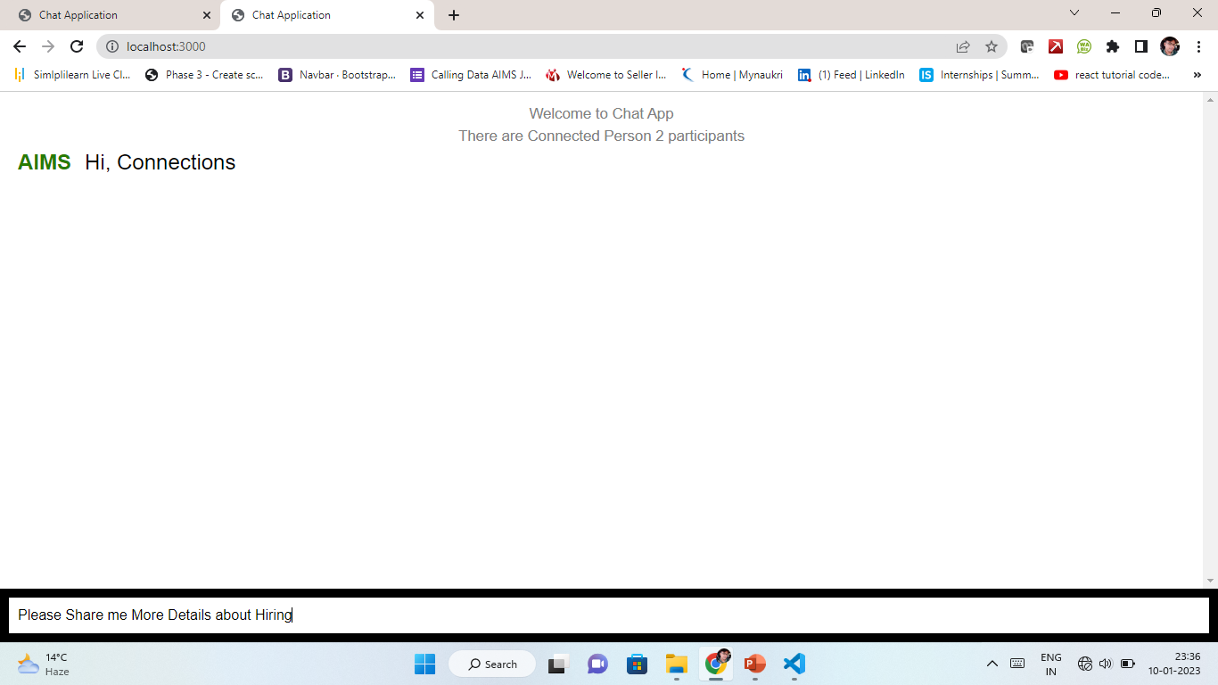
Typing A
Chat-2

Slide 6
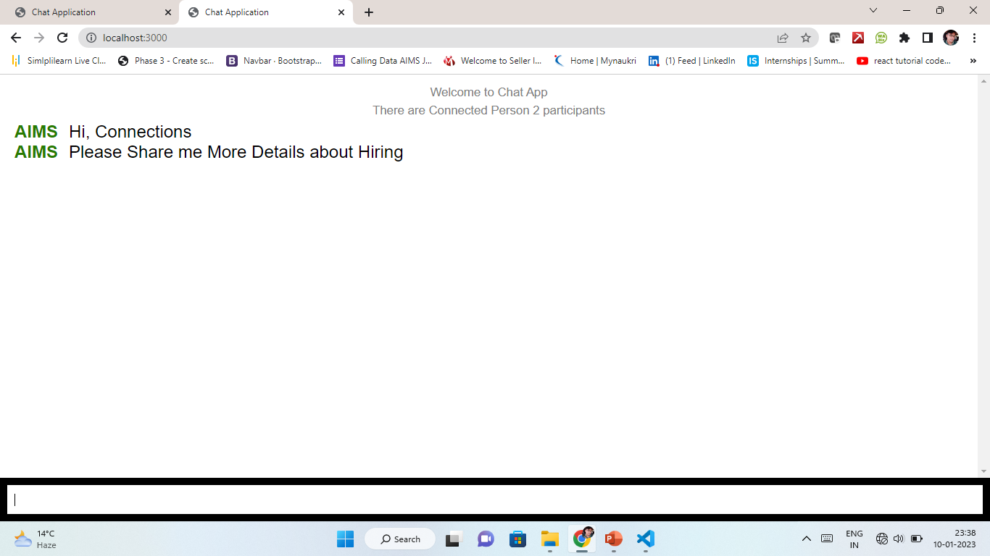
Typing A
Chat-2

Slide 7
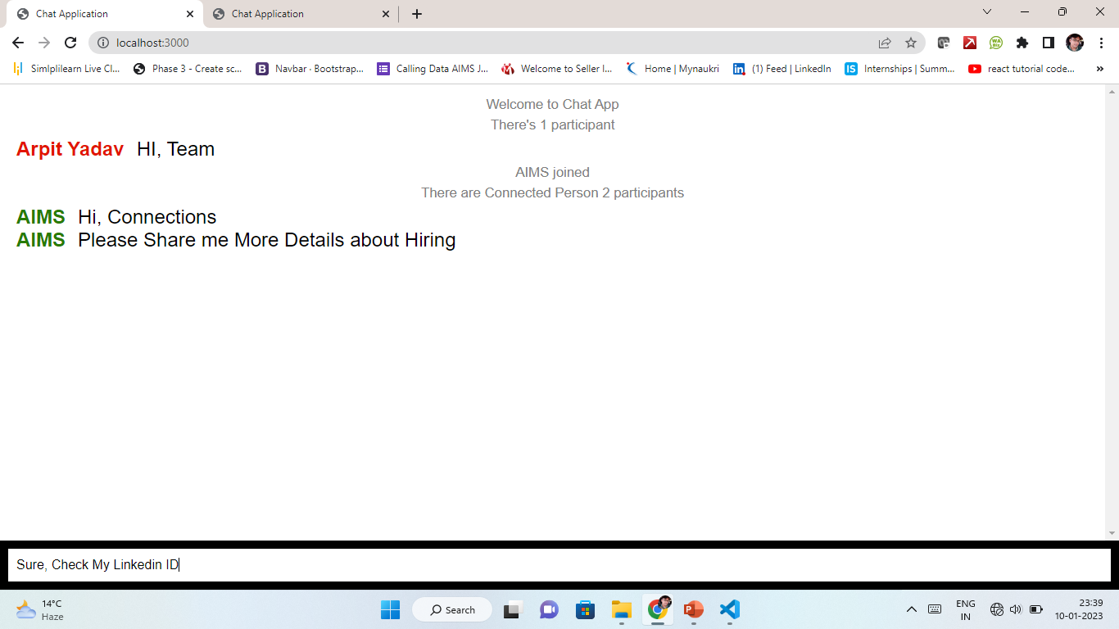
Typing A
Chat-1

Slide 8
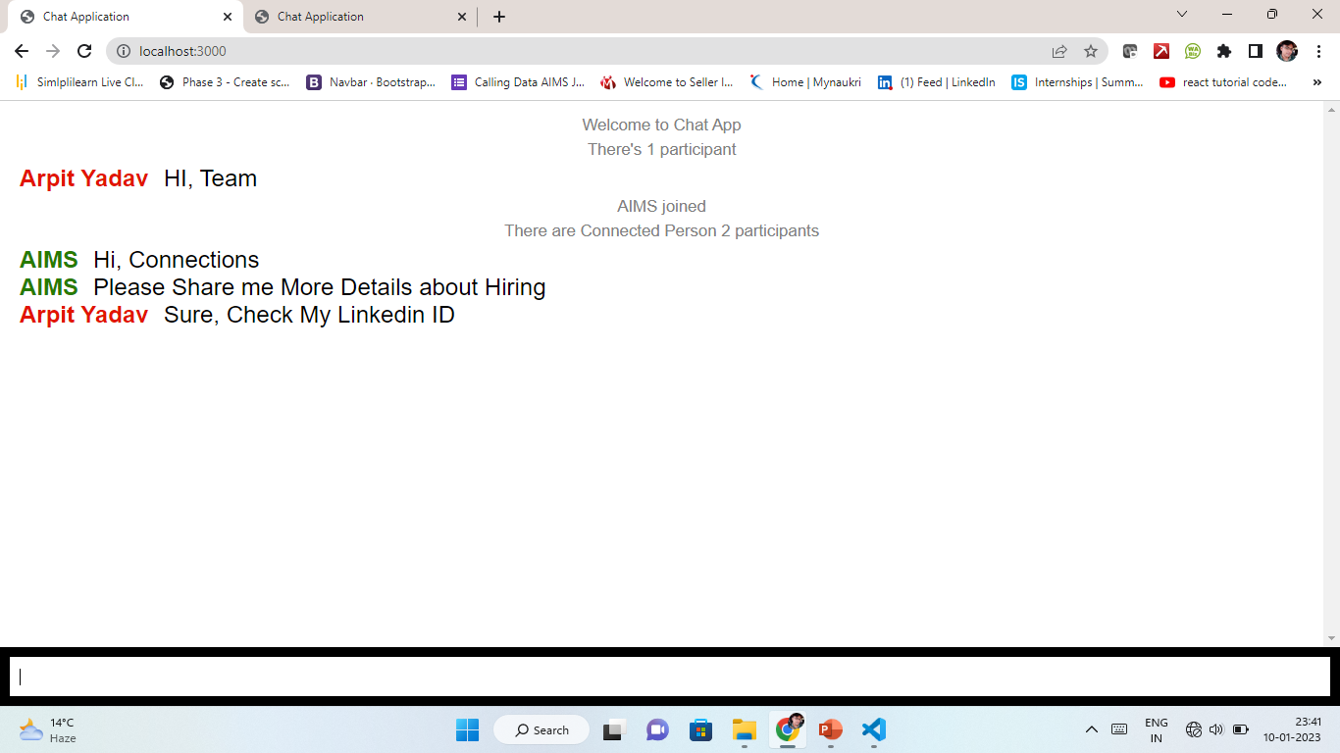
Typing A
Chat-1

Slide 9
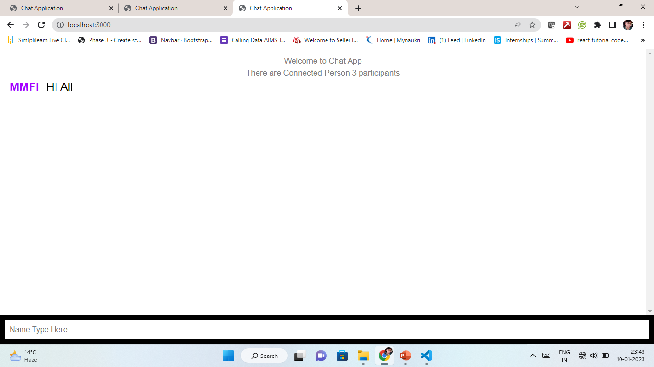
Typing A
Chat-3

Slide 10
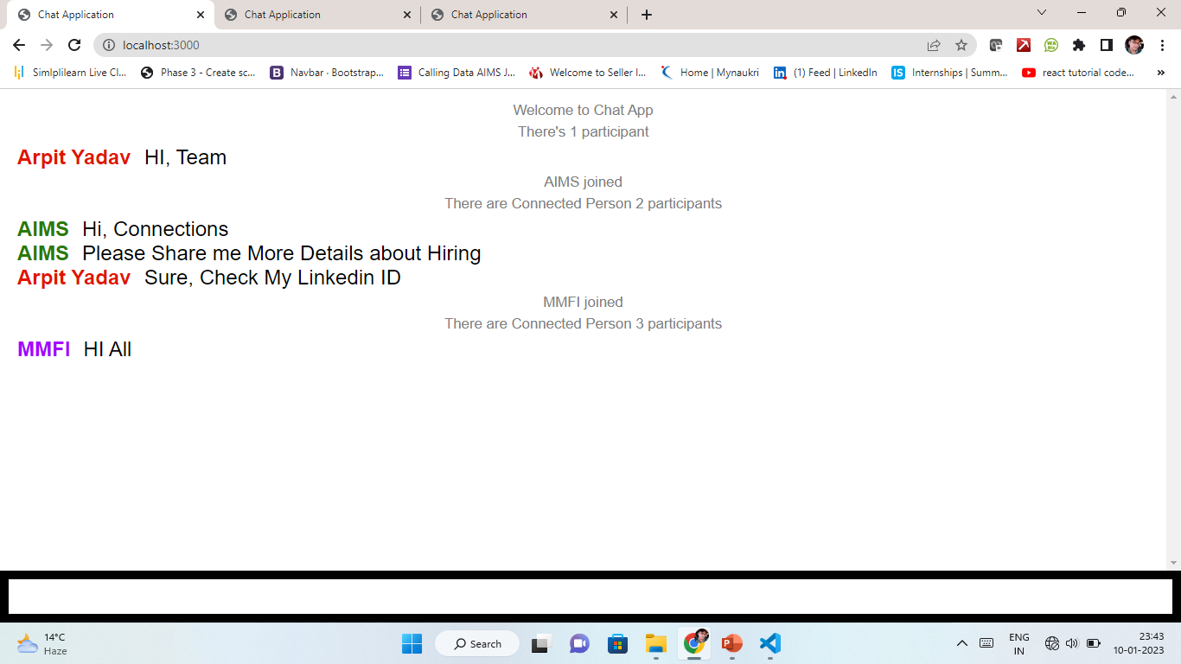
Typing A
Chat-1
Seen

Slide 11
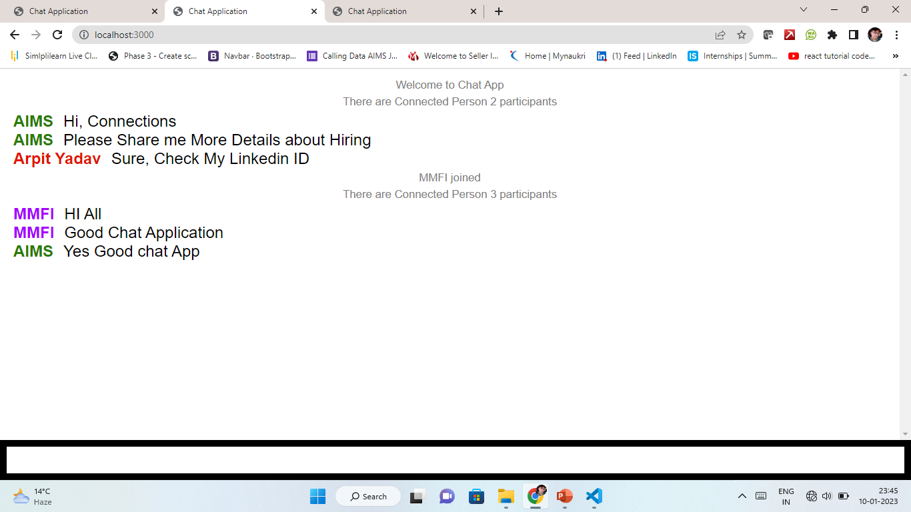
Typing A
Chat-2
Seen

Slide 12
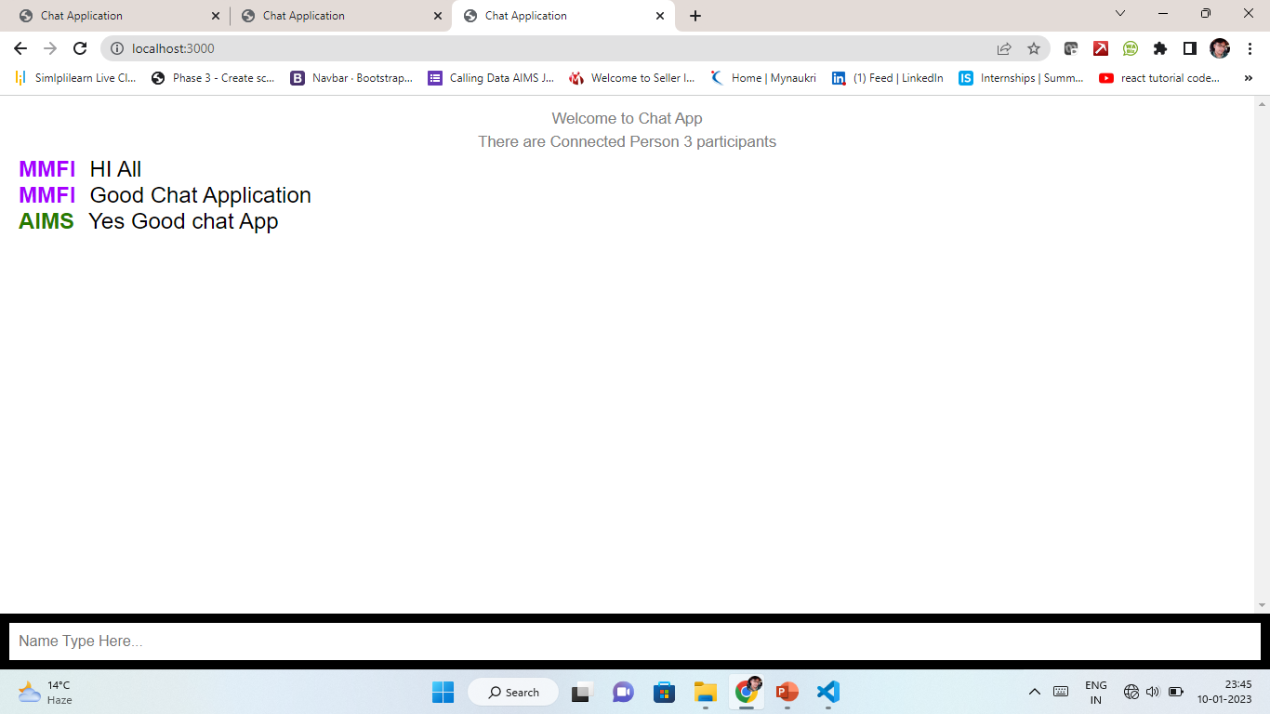
Typing A
Chat-3
Seen

